Slide 1
SECURE DATA HIDING IN IMAGES USING STEGANOGRAPHY
CAPSTONE PROJECT
Presented By:Shylaja Gunti
Student Name : Shylaja Gunti
College Name & Department :Chaitanya Institute of Technology and science,ECE.

Slide 2
OUTLINE
Problem Statement
Technology used
Wow factor
End users
Result
Conclusion
Git-hub Link
Future scope

Slide 3
Problem Statement
With the rise of digital communication, ensuring data privacy and security has become a critical challenge. Traditional encryption methods secure messages but may attract unwanted attention. Steganography, the practice of hiding information within digital media, offers a discreet way to transmit confidential data without raising suspicion.
This project aims to develop a steganographic system for embedding secret messages within images while maintaining their visual integrity. The solution should ensure minimal distortion, high payload capacity, and resistance to detection methods. Additionally, the system should support efficient encoding and decoding processes, making it accessible for secure communications in various applications, including confidential messaging and digital watermarking.
The key challenges include maintaining image quality, preventing message extraction by unauthorized users, and optimizing the trade-off between data hiding capacity and imperceptibility. Addressing these challenges will contribute to enhancing secure communication in an era of increasing cybersecurity threats.

Slide 4
Technology used
Languages: Python.
Libraries: OpenCV, OpenStego ,String
Platforms: Operating System: Windows, macOS, Linux
Python Version: Python 3.x
Development Environment:
VS Code, Jupyter Notebook

Slide 5
Wow factors
Encryption and decryption are performed without relying on external GUI frameworks, ensuring a streamlined and user-friendly terminal interface.
Python enables smooth execution across Windows, macOS, and Linux without the need for complex dependencies or bulky installations.
This CLI-based system simplifies encryption and decryption with easy file selection and clear status messages, unlike GUI-based tools.

Slide 6
End users
The end users of a Secret Message Hiding in Image Using Steganography system can vary depending on the use case. Here are some potential users:
1. Cybersecurity Professionals & Ethical Hackers
Use steganography for secure communication without attracting attention.
Test and analyze steganographic techniques for vulnerability assessments.
2. Journalists & Whistleblowers
Send confidential information securely without raising suspicion.
3. Military & Intelligence Agencies
Exchange covert messages in high-risk zones.
4. Business & Corporate Users
Protect trade secrets and intellectual property.
5. General Internet Users & Privacy Advocates
Protect personal communications from surveillance or hacking.
6. Law Enforcement & Forensic Experts
Investigate cases of hidden data transmission in cybercrimes.
7. Digital Watermarking & Copyright Protection
Artists, photographers, and filmmakers can embed copyright information in their work.
8. Researchers & Academics
Study steganography for developing new algorithms and cryptographic techniques.

Slide 7
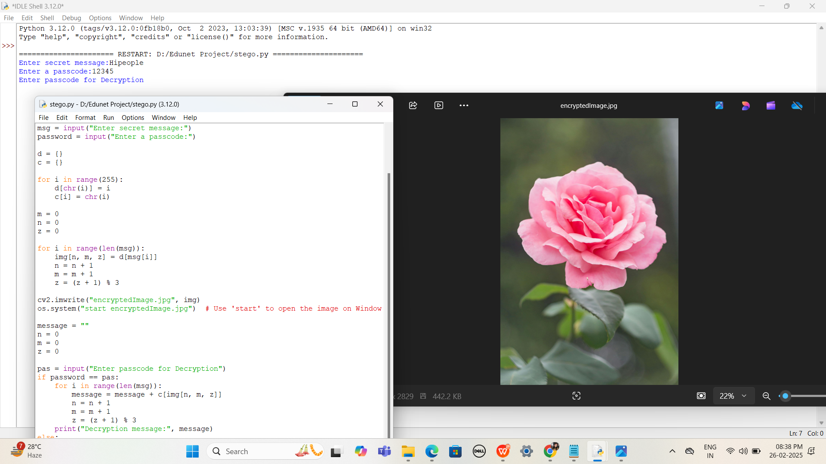
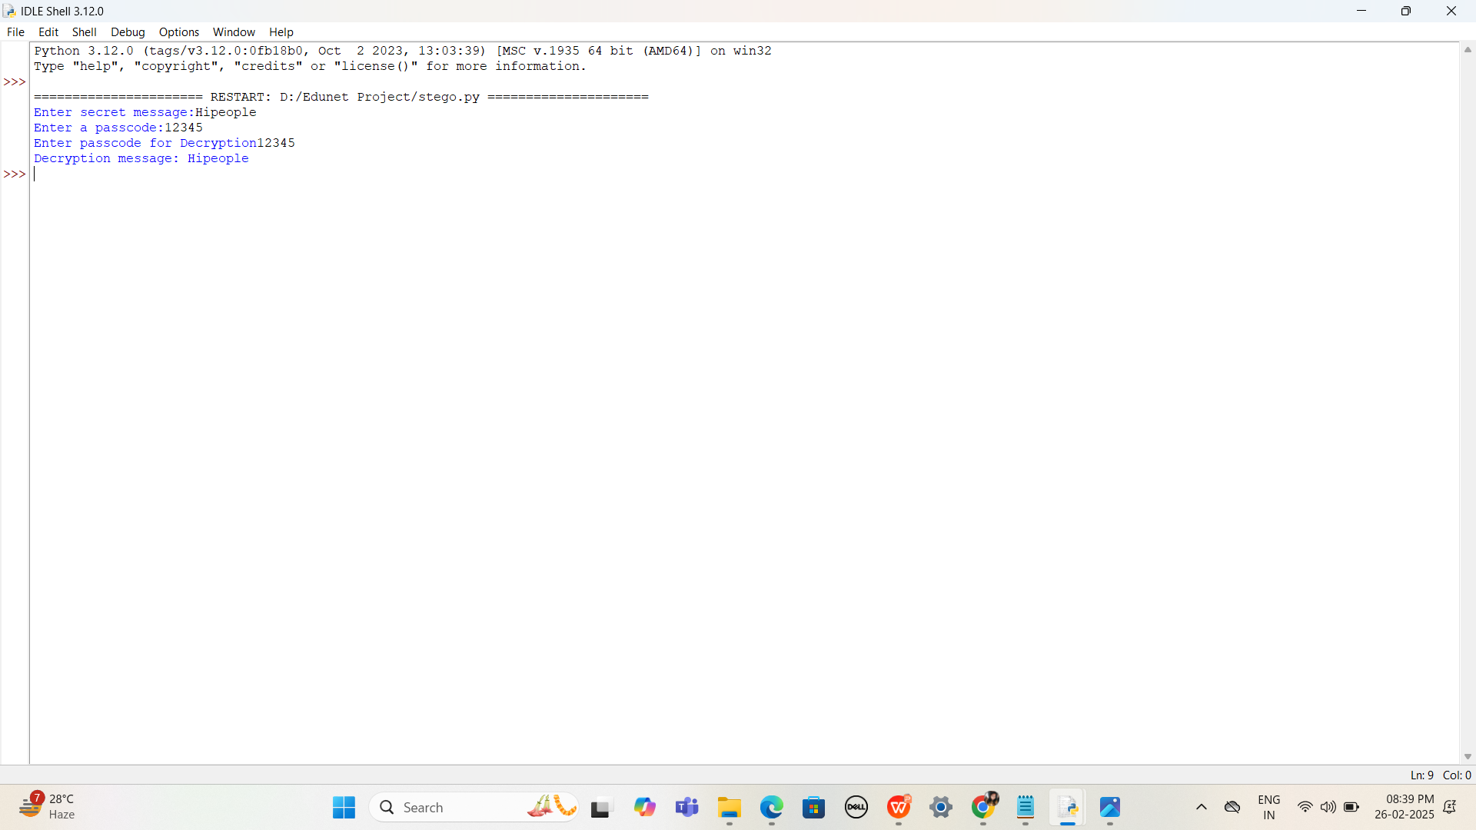
Results

Slide 8
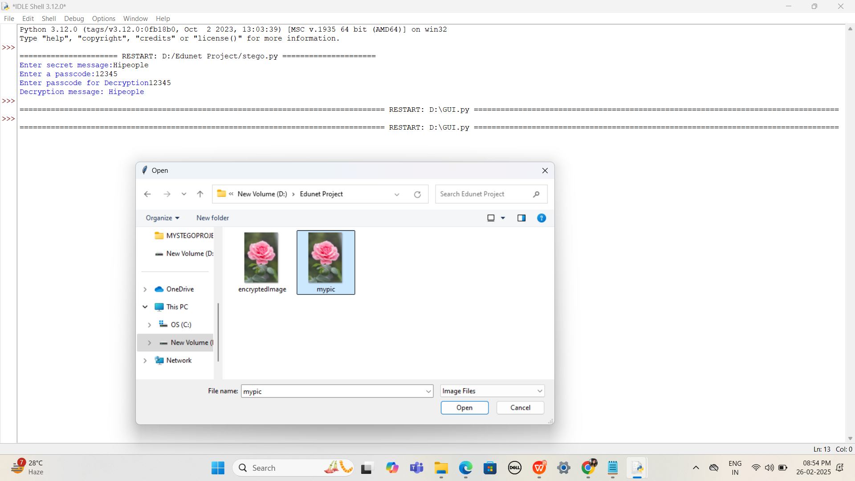
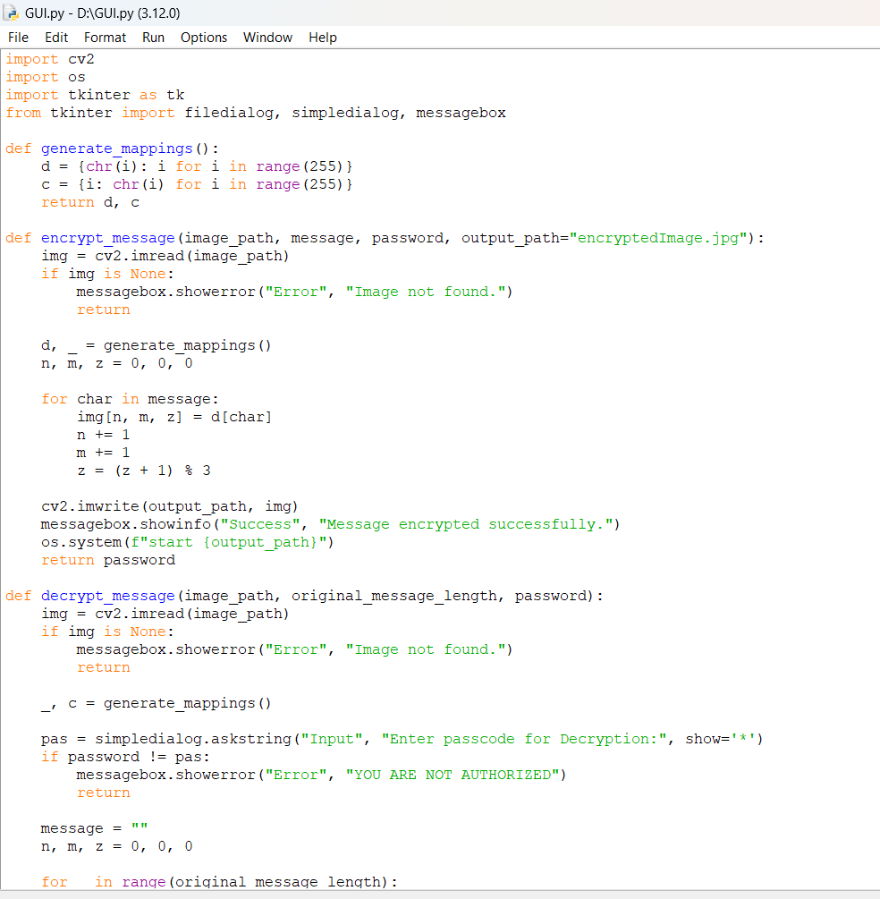
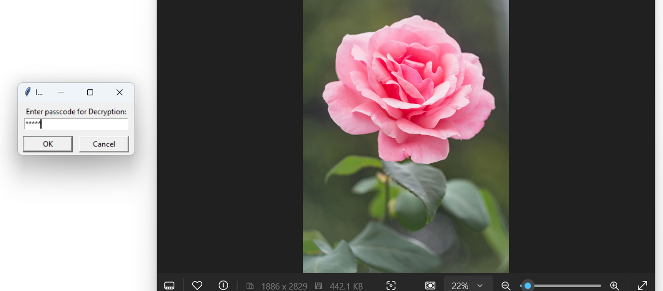
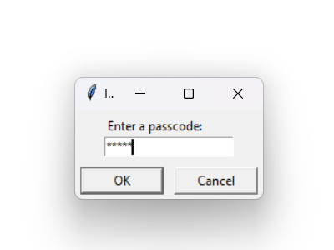
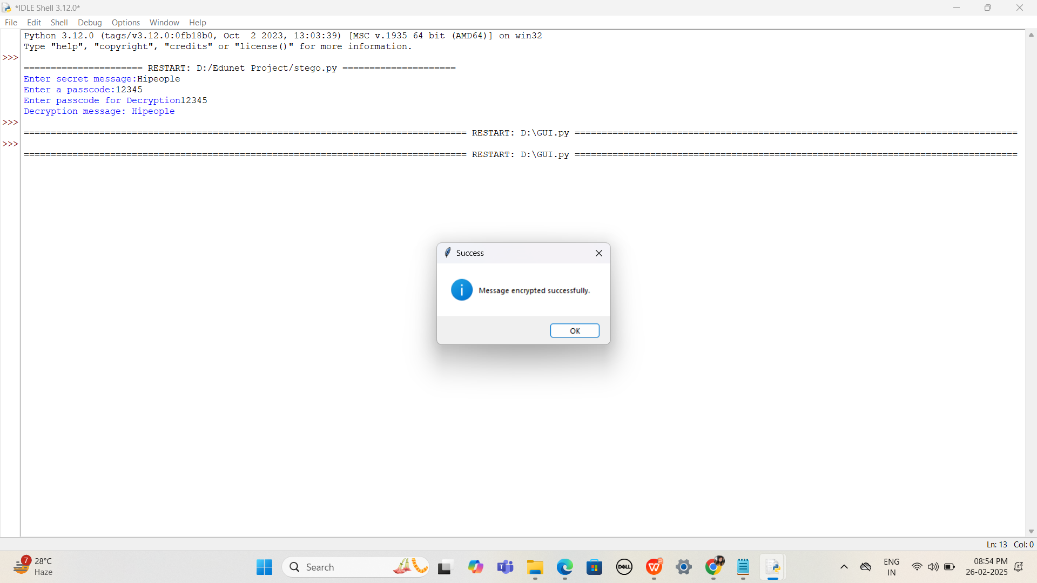
GUI BASED RESULTS

Slide 9
Conclusion
In this project, we successfully implemented a steganographic system for securely embedding and retrieving secret messages within digital images. By leveraging techniques such as Least Significant Bit (LSB) substitution, encryption, and compression, we ensured that hidden data remains undetectable while preserving the visual integrity of the image.
The project addressed critical challenges in steganography, including data capacity, security, and resistance to detection methods. The integration of encryption (AES/RSA) and randomized pixel selection enhanced the confidentiality and robustness of the system, making it suitable for applications such as secure communication, digital watermarking, and forensic investigations.
Overall, this project demonstrates the effectiveness of steganography as a covert communication method in the digital era. Future enhancements may include deep learning-based steganography, cloud integration, and mobile-friendly implementations to further improve security, usability, and accessibility.

Slide 10
GitHub Link
https://github.com/Guntishylaja/Edunet-Project.git

Slide 11
Future scope(optional)
1. Advanced Steganographic Techniques
Deep Learning-Based Steganography – Using neural networks (e.g., GANs, autoencoders) to hide and extract messages imperceptibly.
2. Enhanced Security Measures
Blockchain-Based Steganography – Storing stego-images on decentralized ledgers for tamper-proof security.
Multi-Layered Encryption – Implementing dual-layer encryption (AES + RSA) before embedding to add an extra security layer.
3. Cross-Platform Integration
Mobile Application Development – Implementing steganography on Android and iOS for secure communication on mobile devices.
4.Legal and Ethical Considerations
Forensic Steganography – Helping law enforcement track cybercrime-related hidden communications.

Slide 12
THANK YOU

